Slide 1
Faculty Senate - ITCC
Spring Semester 2026
May 14, 2026

Slide 2
Vote of No Confidence for S&T CIO: Background
Based on numerous complaints communicated to ITCC members, coming from both faculty and staff regarding IT policies and actions, the ITCC conducted two campuswide satisfaction surveys: the first in the spring and second six months later in the fall of 2025. The spring survey revealed considerable dissatisfaction, and the fall survey showed no meaningful improvement.

Slide 3
Vote of No Confidence for S&T CIO
    During the April 10 ITCC meeting, after discussion of the 2025 survey results, and hearing additional objections to IT policies and practices from Computer Science, a motion was made and seconded for a vote of no confidence (VONC) in our current CIO. After some discussion, a friendly amendment was proposed and accepted to poll faculty by department to directly gage the level of support for a VONC with the understanding that a majority in favor of the VONC would support the motion, or failing to reach a majority, defeat it.

Slide 4
Department Faculty Poll
I support a motion for a vote of "no confidence" in our CIO, Barry Robbins, in Faculty Senate.
I do not support a motion for a vote of "no confidence" in our CIO, Barry Robbins, in Faculty Senate.

Slide 5
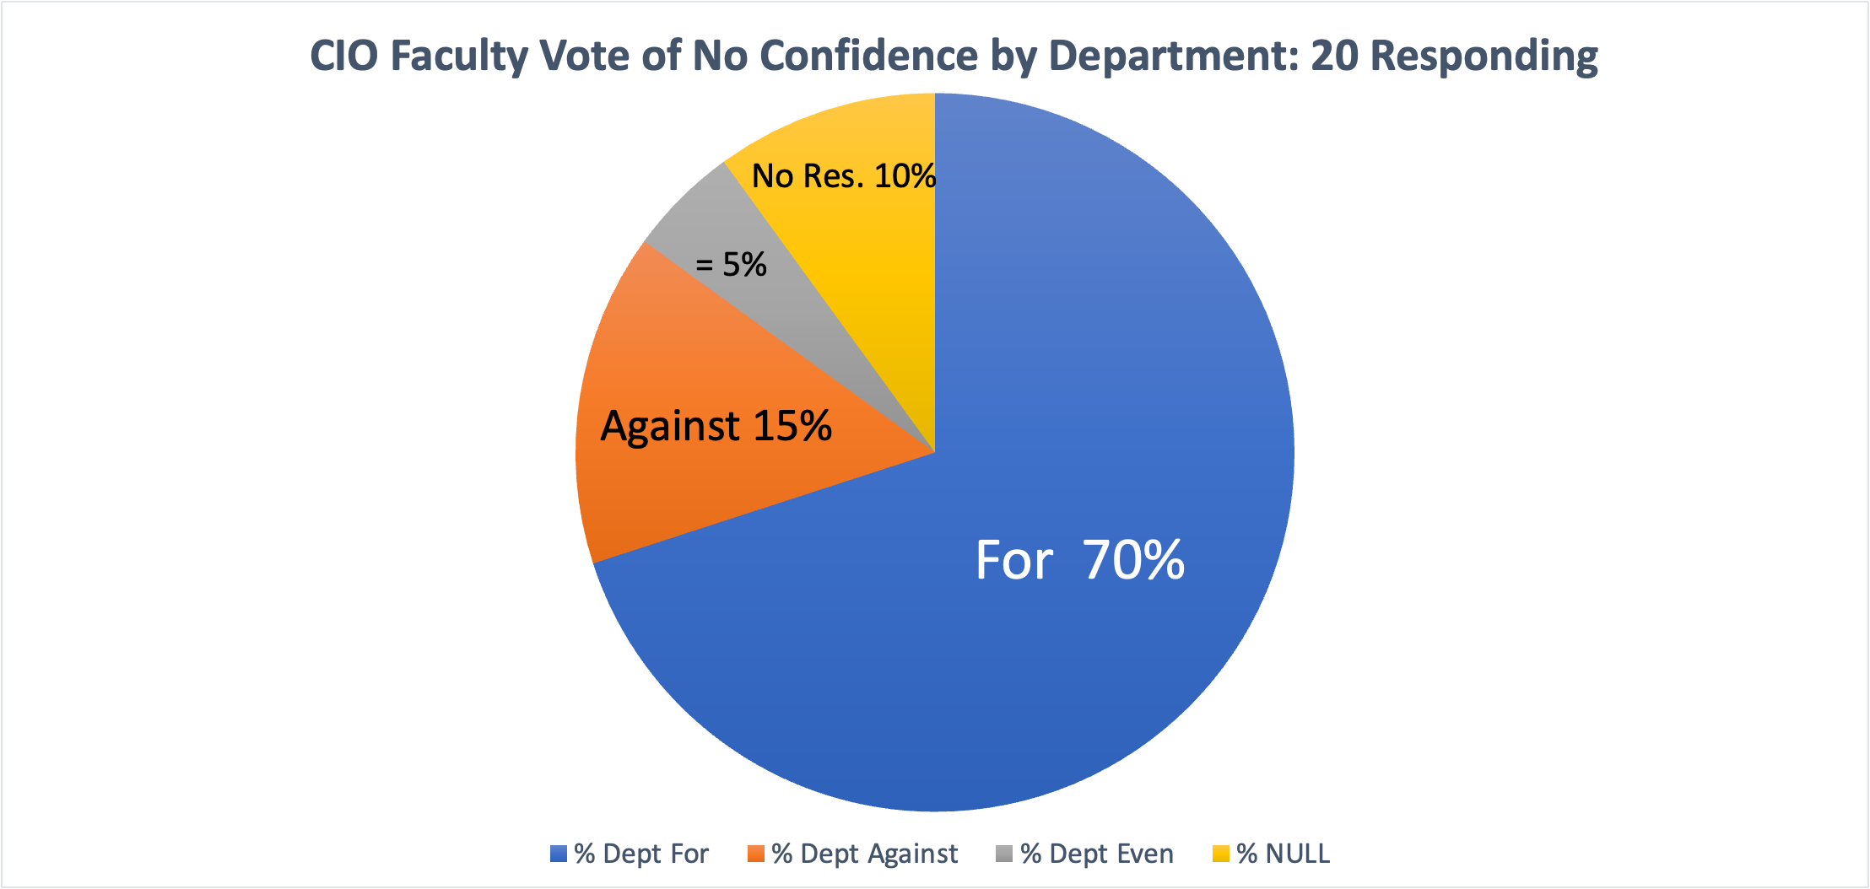
Poll Results

Slide 6
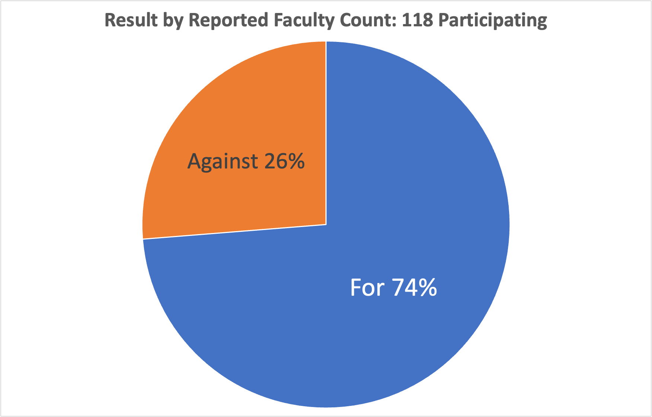
Poll Results

Slide 7
Resolution:
Vote of No Confidence in the Chief Information Officer (CIO)
ITCC/Faculty Senate Resolution:
Vote of No Confidence in the Chief Information Officer (CIO)
Missouri University of Science and Technology
WHEREAS Missouri S&T’s mission in research, teaching, and service depends on effective, responsive, and mission-aligned IT services and infrastructure;
WHEREAS Current IT policies and practices have introduced persistent barriers, including delayed support, restrictive access controls, inefficient approval processes, and limited faculty consultation;
WHEREAS These constraints impair research productivity, instructional quality, and the ability to meet funding and project obligations;
WHEREAS Results from Spring and Fall 2025 IT surveys show no meaningful improvement, with continued negative faculty assessments of research support, customer experience, and the impact of security policies, and overall conclusions indicating little progress;

Slide 8
WHEREAS Documented issues include excessive approval timelines, restrictive administrative policies, and reduced effectiveness of IT operations;
WHEREAS These conditions undermine the university’s strategic goals, including research competitiveness, instructional innovation, and maintenance of R1 status, and diminish the impact of major institutional investments, including the Kummer Institute;
WHEREAS The lack of effective shared governance in IT decision-making is inconsistent with faculty roles in academic mission oversight;
THEREFORE, BE IT RESOLVED – that the ITCC/Faculty Senate expresses no confidence in the leadership of the Chief Information Officer (CIO);
BE IT FURTHER RESOLVED – The Faculty Senate calls for immediate reform of IT governance, alignment of IT strategy with research and teaching needs, and establishment of clear accountability mechanisms;
BE IT FINALLY RESOLVED – This resolution be communicated to university leadership for prompt action.

Slide 9
What We Want
Complete administrative authority on our computers and those in our laboratories.
Complete freedom to purchase or install any legally available hardware or software.
IT must adapt a more user-centric and supportive role to help faculty create innovation in teaching and research thereby promoting the goals of this university.

